Slide 1
Lecture 5
8086 Microprocessor
Flag register
Addressing modes

Slide 2
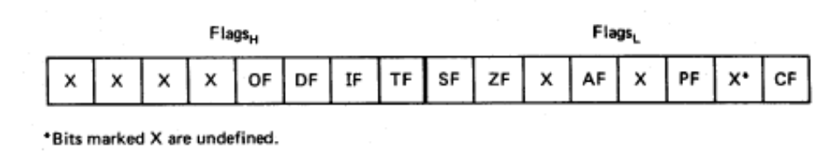
Flags
Carry flag
Overflow
Direction
Parity flag
Interrupt enable
Auxiliary flag
Trap
Zero
Sign
6 are status flags
3 are control flag

Slide 3
Flag Register
Conditional flags:
  They are set according to some results of arithmetic operation. You do not need to alter the value yourself.
Control flags:
  Used to control some operations of the MPU. These flags are to be set by you in order to achieve some specific purposes.
Flag |  |  |  |  | O | D | I | T | S | Z |  | A |  | P |  | C
Bit no. | 15 | 14 | 13 | 12 | 11 | 10 | 9 | 8 | 7 | 6 | 5 | 4 | 3 | 2 | 1 | 0
CF (carry) Contains carry from leftmost bit following arithmetic, also contains last bit from a shift or rotate operation.

Slide 4
Flag Register
OF (overflow) Indicates overflow of the leftmost bit during arithmetic.
DF (direction) Indicates left or right for moving or comparing string data.
IF (interrupt) Indicates whether external interrupts are being processed or ignored.
TF (trap) Permits operation of the processor in single step mode.

Slide 5
SF (sign) Contains the resulting sign of an arithmetic operation (1=negative)
ZF (zero) Indicates when the result of arithmetic or a comparison is zero. (1=yes)
AF (auxiliary carry) Contains carry out of bit 3 into bit 4 for specialized arithmetic.
PF (parity) Indicates the number of 1 bits that result from an operation.

Slide 6
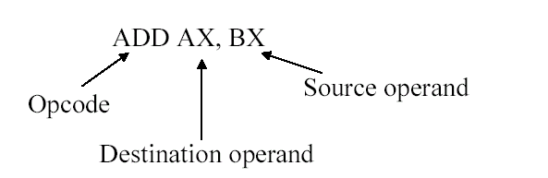
8086 Addressing
Instructions/ opcodes refer data to be processed:
e.g.
There are varying ways to locate the source and the destination of data. These techniques are called addressing modes.
Addressing modes locate data in:
  Immediate and register data
  Data in memory
  Data of I/O ports
  Relative addressing
  Implied Addressing

Slide 7
Addressing modes (Immediate and register data)
Register addressing (Data moves within processor):
  Specifies the source, destination or both to be in register
  MOV AX, BX
  MOV CL, DL
  Source and destination operand register size must be same
Immediate addressing
  The data is provided in the instruction.
  Source is immediate data and destination is register.
  MOV CL, 05H
  MOV AX, 0502H

Slide 8
Addressing modes (for data access in memory)
For accessing memory 20 bit physical address (PA) is generated using a segment register (CS, DS, SS, ES) content and an offset value.
Different addressing techniques depends on how offset values are generated.
Offset values are also called Effective address (EA)
Physical Address (PA) = Segment register * 10H + EA

Slide 9
Addressing modes (for data access in memory)
Direct addressing:
  The instruction operand specifies the effective address where data is located within the segment.
    Default segment register is DS
  MOV [0020H], DL; copies DL into memory location DS:0020H
    For DS=3050H, Physical address=?
      EA= 0020H
      PA= 30500H + 0020 = 30520H
  MOV ES:[1234H], AX; copies AX into memory location ES:1234H
    For ES=1250H, Physical address=?
  MOV AX, [0040H]; copies 16- bit data from location DS:0040H into AX
    For DS=3050H, Physical address=?

Slide 10
Example
Given AX=0000H, BX=1234H, CX=6666H, DX=0020H, DS=2000H, ES=3000H, 2000:0020H=22, and 3000:0020=33H, indicate the changes in each step in the following program:
MOV AX,3000H
; Copies 3000H into AX
MOV DS, AX
; Copies AX, i.e. 3000 into DS
MOV DL, [0020H]
; Copies content of 3000:0020H, i.e. 33H into DL
MOV AX, 2000H
; copies 2000H into AX
MOV ES, AX
; Copies AX, i.e. 2000 into ES
MOV DL. ES:[0020H]
; Copies content of 2000:0020H, i.e. 22H into DL
MOV AL, DL
; Copies DL, i.e. 33H into AL

Slide 11
Addressing modes (for data access in memory)
Register Indirect addressing
  Instruction specifies a register containing an effective address, where data is located.
  This addressing mode works with SI, DI, BX and BP registers for EA.
  SI, DI, BX are used with DS (by default) and ES (Must be mentioned in the instruction) and BP with SS by default.
  MOV CL, [BX]; copies 8-bit data from location DS:[BX] into CL
  MOV CL, ES:[BX]; copies 8-bit data from location ES:[BX] into CL
  MOV [SI], DX; MOV CL, [BX]; copies DX into memory location DS:[SI]
    For DS=3050H, and SI =0050H, Physical address=?

Slide 12
Addressing modes (for data access in memory)
Based addressing:
  8-bit or 16-bit instruction operand is added to the contents of a base register (BX or BP), the resulting value is a pointer to location where data resides.
  Default segment register is DS for BX and SS for BP
  EA = [BX] or [BP] + 8-16 bit displacement (number)
  MOV [BX]20H, DL;
    For DS=3050H, BX=70H Physical address=?
  MOV AX, [BP]40H
    For SS=3050H, BP=0100H
      Physical address=?
  Example: BX contains offset of the first element of an array of words. Write instructions to copy the fourth and sixth elements into CX and DX without altering BX.
    MOV CX, [BX]3; copies fourth element in the array into CX
    MOV DX, [BX]5; copies sixth element in the array into DX

Slide 13
Addressing modes (for data access in memory)
Indexed addressing:
  8-bit or 16-bit instruction operand is added to the contents of a base register (SI or DI), the resulting value is a pointer to location where data resides.
  Default segment register is DS.
  EA = [SI] or [DI] + 8-16 bit displacement (number)
  MOV [DI]20H, DL
    For DS=3050H, DI=70H
      Physical address=?

Slide 14
Addressing modes (for data access in memory)
Based Indexed addressing:
  the contents of a base register (BX or BP) is added to the contents of an index register (SI or DI), the resulting value is a pointer to location where data resides.
  Default segment register is DS when BX is used and SS for BP
  EA = [BX] or [BP] + [SI] or [DI]
  MOV [BX][DI] 20H, DL
    For DS=3050H, BX=70H, DI=30H, EA=?
    Physical address=?
  MOV AX, [BP][SI]40H
    For SS=3050H, BP=0100H, SI=90H, EA=?
      Physical address=?

Slide 15
Addressing modes (for data access in memory)
Based Indexed addressing with displacement:
  8-bit or 16-bit instruction operand is added to the contents of a base register (BX or BP) and index register (SI or DI), the resulting value is a pointer to location where data resides. :
  Default segment register is DS when BX is used and SS for BP
  EA = [BX] or [BP] + [SI] or [DI] + 8-16 bit displacement (number)
  MOV [BX][DI]20H, DL
    For DS=3050H, BX=20H, DI=70H, EA=?
      Physical address=?

Slide 16
Example
Write instructions to copy the three elements starting from fifth element of an array into elements starting from tenth element of the array.[ Assume 0002h be the offset of the first element in the array]
MOV BX, 0002H ; 0002h be the offset of the first
; element in the array
MOV SI, 0004H ; points to the fifth element
MOV DI, 0009H ; points to the 10th element
MOV AL, 00 [SI] [BX] ; the fifth element into AL
MOV 00 [DI] [BX], AL ; AL into tenth element
MOV AL, 01 [SI] [BX] ; the sixth element into AL
MOV 01 [DI] [BX], AL ; AL into eleventh element
MOV AL, 02 [SI] [BX] ; the seventh element into AL
MOV 02 [DI] [BX], AL ; AL into twelfth element

Slide 17
Addressing modes (for String data access in memory)
String addressing:
  The String instructions always assume SI as the EA for the first byte or word of the source string and DI as the EA for the first byte or word of the destination of string.
  The contents of SI and DI are automatically incremented (DF=0) or decremented (DF=1) to point to the next byte or word.
  Default segment register is DS for source string and ES for destination string
  EA = [SI] and [DI]
  MOVS BYTE
    For DF=0, DS=3050H, SI=70H, DI=30H,ES=4000H, DI=30H
    EA_{source}=? and EA_{Destination}= ?
    Physical addresses=?

Slide 18
Addressing modes (for data access in I/O ports)
Two types
  Standard I/O: uses port addressing
  Memory mapped I/O: Uses memory addressing modes (Described earlier)
Standard I/O: two types
  Direct port mode:
    The port number is an 8-bit(0-255) number and given in the instruction.
    IN AL, 40H
    OUT 30H, AX
  Indirect port mode
    The port number is a 16-bit and taken from DX (64-k ports)
    IN AX, DX
    OUT DX, AL

Slide 19
Addressing modes (relative & implied)
Relative Addressing:
  Used to locate next instruction (e.g. JUMP)
  Specify operand as a signed 8-bit displacement relative to PC.
  JNC 200H, means if CF=0, then next instruction is in location: PC + 200H; otherwise next instruction is in:PC+1.
Implied Addressing:
  Instruction using this mode have no operands.
  CLC, means clear the carry flag to zero.

